Slide 1
Aztec Journal: Journal # 3
As you get close to Tenochtitlan, you decide to secretly set up camp outside of the city. You send scouts ahead into the city disguised as local inhabitants. (1) You create and draw a design for an Aztec flag in your journal. (2) In at least a 5 FULL REAL SENTENCE description, you write in your journal how the colors and symbols you have chosen for your flag relates to what you have learned about Aztec Empire’s people, religion, agriculture and any other significant practices (see your class notes).

Slide 2
Aztec
Analyze image 1 on the following slide.
Answer the corresponding questions on your handout.

Slide 4
Aztec
Between 1777 and 1960, Congress passed several acts that changed the shape, design and arrangement of the flag and allowed stars and stripes to be added to reflect the admission of each new state. The stripes represent the original 13 Colonies and the stars represent the 50 states of the Union. The colors of the flag are symbolic as well: Red symbolizes hardiness and valor. White symbolizes purity and innocence. Blue represents vigilance, perseverance and justice.

Slide 5
Aztec
Analyze image 2 on the following slide.
Answer the corresponding questions on your handout.

Slide 6
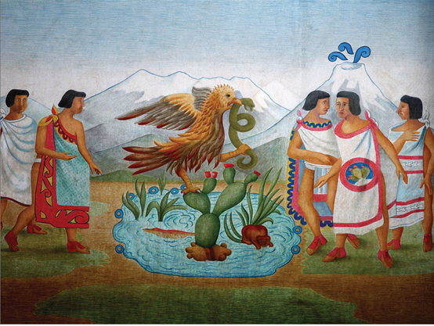

Slide 7
Aztec
According to legend, Aztec priests received a vision that they were to build their capital Tenochtitlan, an island in the middle of Lake Texcoco, where they found an eagle perched on a cactus eating a serpent, or snake.

Slide 8
Aztec
Analyze image 3 on the following slide.
Answer the corresponding questions on your handout.

Slide 9
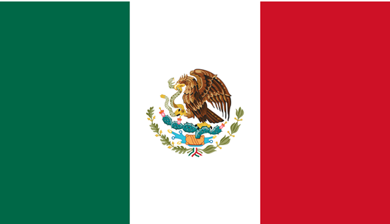

Slide 10
Aztec
Originally, the colors of the Mexican flag held different meanings than today. The green stripe was said to represent Mexico’s independence from Spain. The color red indicated the union between the Americas and Europe, as the elite class still identified with its European roots. The white color was established to symbolize the purity of the Catholic religion. Today, the meaning behind the colors has changed: Green represents hope. White symbolizes purity. Red stands for the blood of the heroes who fought for independence.

Slide 11
Aztec
In partners:
Read The Aztecs: Background
Discuss and answer the corresponding questions on your handout.

Slide 12
The Aztec: Background
During what years was Aztec society at its height? In what year did Hernan Cortes and the conquistadors arrive from Spain?
1350-1519
1519
Where did the Aztecs migrate to? How large was their population?
Shores of Lake Texcoco around 1100 CE
10,000
About how many deities (gods) did the Aztecs worship?
At least 128

Slide 13
The Aztec: Background
Who was Huitzilopochtli? Why do you think the Aztecs worshipped Huitzilopochtli?
Huitzilopochtli was the most important god, the sun god, who struggled to keep the night at bay and bring warmth to the world.
He needed strength in order to carry out his duties, and the Aztecs believed human blood and hearts provided the necessary nourishment.

Slide 14
Aztec
In partners:
Analyze Documents A, B, C, D and E.
Discuss and answer the corresponding questions on your handout.

Slide 15
Document A: Territorial Acquisitions by Aztec Rulers
According Source 1, who was the first Aztec ruler to conquer lands in central Mexico? How did the Aztecs acquire new pieces of land?
Itzcoatl
By conquest (war)
The area of the state of Ohio is about 40,000 square miles. At its peak, how did the Aztec Empire compare? Give examples.
Roughly twice the size of Ohio (about 80,000 square miles).
At its furthest points, the empire stretched more than 600 miles northwest to southeast and about 300 miles across its width.

Slide 16
Document A: Territorial Acquisitions by Aztec Rulers
According to Source 2, what was tribute? Who demanded it and from whom?
Tribute was payment in goods and/or services rather than in currency (money).
The Aztec ruler demanded it from a weaker state to give to the Aztec empire.
What information does Source 2 give about Aztec agriculture? What information does Source 2 give about Aztec economy?
Agriculture: Gourds were grown, cotton was raised, honey was gathered.
Economy: A no-choice tax system, cotton and textiles, metal working (copper axes), Administrative system – tribute (tax) collection.

Slide 17
Document B: Tenochtitlan
In Source 1, what geographic features surround Tenochtitlan? What linked the island to the mainland?
Surrounded by water and mountains in the background.
Three causeways linked the island to the mainland with the longest stretching 5 miles.
According to Source 1, in 1519 what was the population of Tenochtitlan? How much more populated was Tenochtitlan than London?
300,000
5 times the size of London at the time.

Slide 18
Document B: Tenochtitlan
In Source 2, who was Bernal Diaz del Castillo? What was his impression of the Aztec marketplace? Use evidence from the source.
Conquistador who accompanies Hernan Cortes on the 1519 encounter of the Aztecs.
Great marketplace where you could hear people 3 miles away; so well regulated and arranged, never seen anything like it.
In Source 3, what do you notice about the middle temple? What is the name of it?
Larger than the rest; two staircases.
Great Temple, which was 150 feet into the sky.
According to Source 3, what is a ceremonial precinct (where the people are gathered in the middle of the painting)?
At the center of Tenochtitlan was a ceremonial plaza, or precinct, where the Aztecs gathered for religious rituals, feasts and festivals.

Slide 19
Document C: Aztec Life
According to Source 1, what are two reasons the ball game was played? What do scientists also believed the game was used for?
Ritual, religion, and recreation.
Ease tension and often resolve conflicts associated with land, taxation, and trade disputes.
According to Source 2, what are the two social classes in Aztec society? Who occupied most of the important political positions and economic resources in Aztec society? Who was the highest level of nobility?
Nobility and the commoners
Nobility
King (tlatoani)

Slide 20
Document C: Aztec Life
According to Source 2, how did tribute play a role in Aztec social classes?
lower-ranking nobles paid tribute to kings.
In Source 3, describe a child at age 3, age 6, and age 15. What age did boys and girls marry?
Age 3: given life-like toys such as a small loom or grinding stone and was assigned certain household tasks
Age 6: took on broader domestic responsibilities
Age 15: began regular schooling
Boys 20, Girls 16
According to Source 3, what inferences can be made about the parent-child relationship and Aztec family life?

Slide 21
Document D: Chinampas Agriculture
Describe what you see in the image of Source 1. What were chinampas? How might you use this image to argue for the importance of agriculture in Aztec society?
Aztecs cultivating their Chinampas or “floating gardens”
Plots and access paths were systematically laid out.
An acre is about the size of a football field. According to Source 2, how many acres of chinampas surrounded Tenochtitlan?
20,000 acres.
According to Source 2, what kept the soil of the chinampas from oozing into the network of canals? What anchored each chinampas plot to solid ground beneath the water level?
Willow trees were planted at the corners and along side the beds.
Their root system anchored the bed to the shallow lake.

Slide 22
Document D: Chinampas Agriculture
From Source 1 and Source 2, what inferences can you make about law and order in Aztec society?
Plots and access paths are systematically laid out.
Great organization, cooperation, respect and protection of private gardens.
Respect for law and order and a clear set of rules for maintaining physical structure of the chinampas and farmer conduct.

Slide 23
Document E: The Scale of Sacrifice
According to the Scribe in Source 1, who was sacrificed? What did he become?
Seasoned warrior.
Changed from a human into the god Tezcatlipoca.
In Source 1, how did the Scribe describe the victim before he is sacrificed? Why were some saddened?
Treated like royalty; given all the finest luxuries from the nobles’ storehouses, including foods, clothes, teachers, women, and instruction.
They became attached.

Slide 24
Document E: The Scale of Sacrifice
According to the passage from Friar Diego Duran in Source 2, who are the people being sacrificed? Who did the sacrificing?
The victims were prisoners of war taken by the Aztecs at a place called Teuclepec.
Aztec rulers, Motecuhzoma and Chihuacoatl.
According to Source 2, when did the sacrifice begin and end? How many were sacrificed? What do you think the purpose of this drawing was?
2,300 people were sacrificed between midday and nightfall, which means a person was killed every 15 seconds for 9 hours.
Purpose was to show the scale of Aztec sacrifice.

Slide 25
Aztec Journal: Journal # 3
As you get close to Tenochtitlan, you decide to secretly set up camp outside of the city. You send scouts ahead into the city disguised as local inhabitants. (1) You create and draw a design for an Aztec flag in your journal. (2) In at least a 5 FULL REAL SENTENCE description, you write in your journal how the colors and symbols you have chosen for your flag relates to what you have learned about Aztec Empire’s people, religion, agriculture and any other significant practices (see your class notes).

