Slide 1
Emperors and Popes Clash Storybook
Use BB, page 263 paragraphs two and three to create a 4 panel storybook using the outline shown in the next two slides
2 panels per paragraph

Slide 3
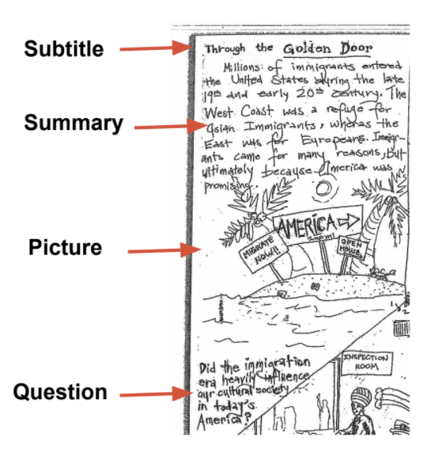
Emperors and Popes Clash

Slide 5
SWEET LEGO VIDEO

Slide 7
Whose side in the conflict do you agree with more Pope Gregory VII or Emperor Henry IV?
Please clearly explain why in 2-3 sentences using evidence from the quotes. On the back of your storyboard

