Slide 1
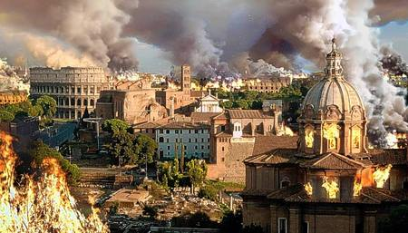
Will the United States soon fall like the Roman Empire did?

Slide 2
Look up EMPIRE on your phone
An extensive group of states or countries under a single supreme authority, formerly especially an emperor or empress.
So…

Slide 4
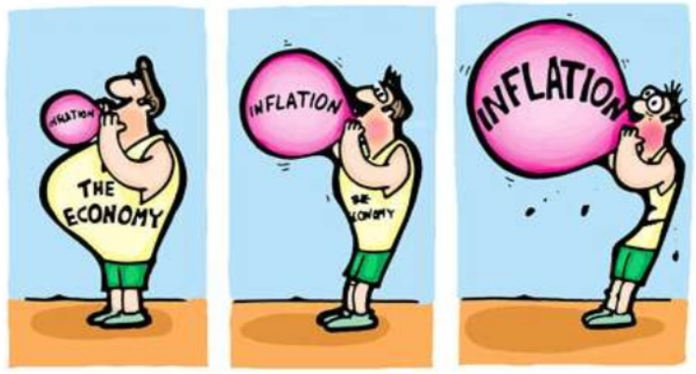
Read the following facts out loud first.
Arrange similar facts into four or five groups.
Write a name for each group.
Write at least three associated facts under each group name.
Example:
Economic
Inflation
Poverty
…
Chelsea FC
Victory
Glory

Slide 5
Prices soared (inflation)
A decline in the spirit of Roman citizenship.
Germanic tribes were pressing on the western border of the empire.
High rate of unemployment (people don’t have jobs)
Dependence on hired non-Roman soldiers, who had little loyalty to Rome
More Romans became poor
Communication across the empire was difficult
Ignored public works like building and repairing roads and aqueducts
Citizens paid heavy taxes to finance Rome’s huge armies
Rome controlled North Africa
Too many slaves taking jobs
Barbarian leader, Odovacar, overthrows the last Roman emperor
Rome controlled Turkey in Asia
Growing corruption - Emperors like Nero and Caligula wasted large amounts of the government’s money on themselves
Military leaders fighting among themselves
Empire was split into two halves
Roman’s paid Goths to not attack Rome
No good system for choosing next emperor
When an emperor died, ambitious rivals with independent armies fought each other for power.
Rising crime made the city of Rome and its roads unsafe for citizens and traders
Farmers leave their lands because they are needed to fight in the Roman army
Vandals, Angles, Saxons, and Jutes invade England

Slide 6
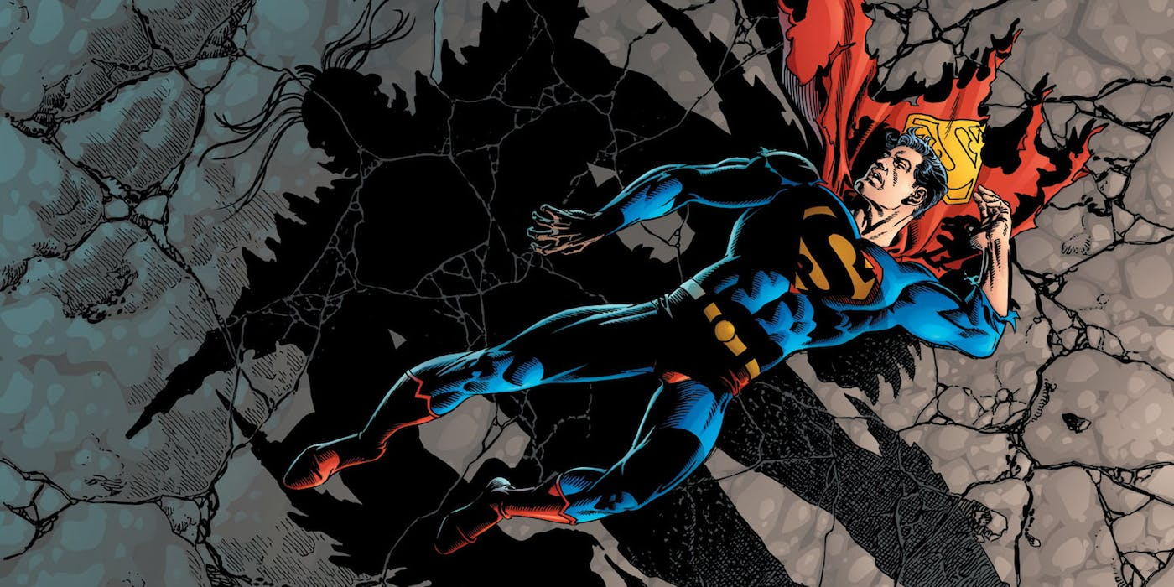
Will the United States soon fall like the Roman Empire did?
Chart on board with Rome categories

