Slide 1
The Crusades
1. Read and answer “If you were there...” BB, p. 264
2. Read Building Background BB, p. 264
3. Read Paragraph 1 BB, p. 264

Slide 2
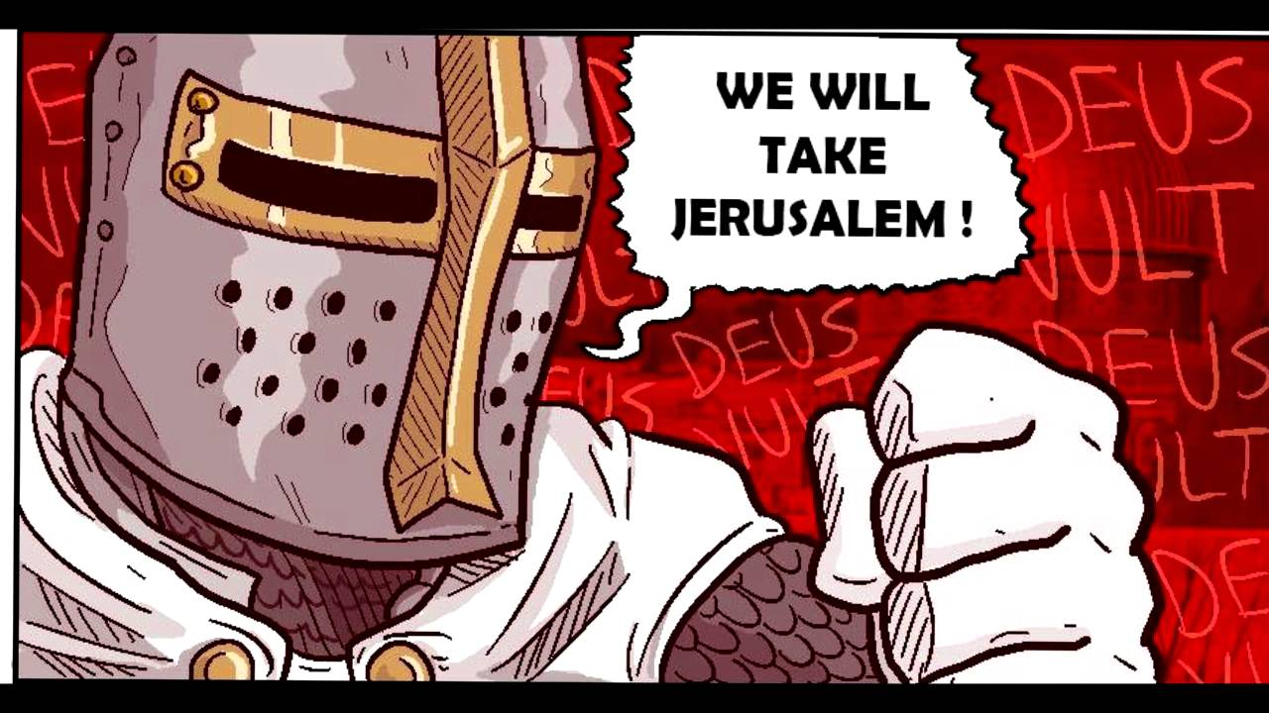
Crusades - a long series of wars between Christians and Muslims between 1096-1291 CE over ownership of the “Holy Land”.

Slide 3
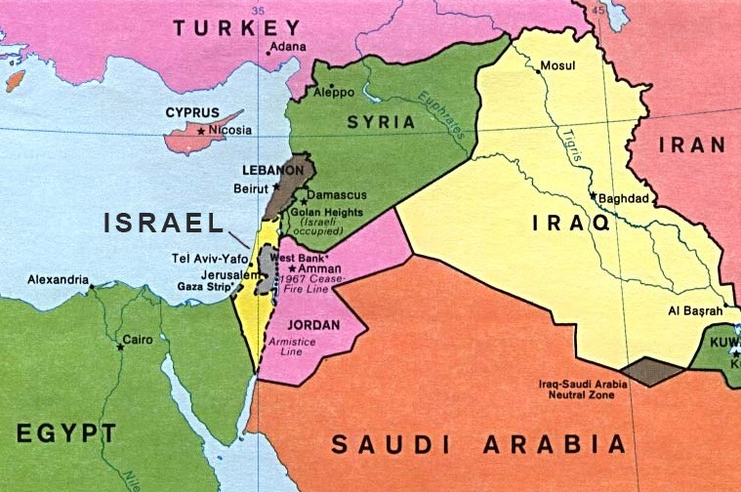
As a geographic term, the description "Holy Land“ loosely encompasses modern-day Israel, the Palestinian territories, Lebanon, western Jordan and south-western Syria.

Slide 4
Includes the city of Jerusalem which has religious significance as the Land of Israel and the religions which descended from ancient Israelites (Judaism, Christianity and Islam). The birth place of Jesus and the site of Isra and Mi'raj of the Islamic faith.

Slide 6
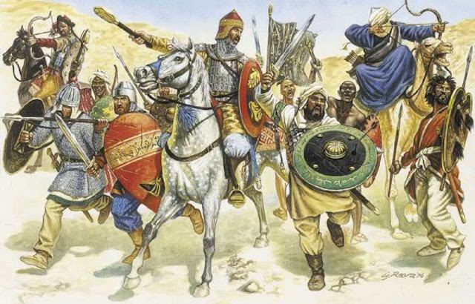
How Did the Crusades Start? Crash Course

Slide 7
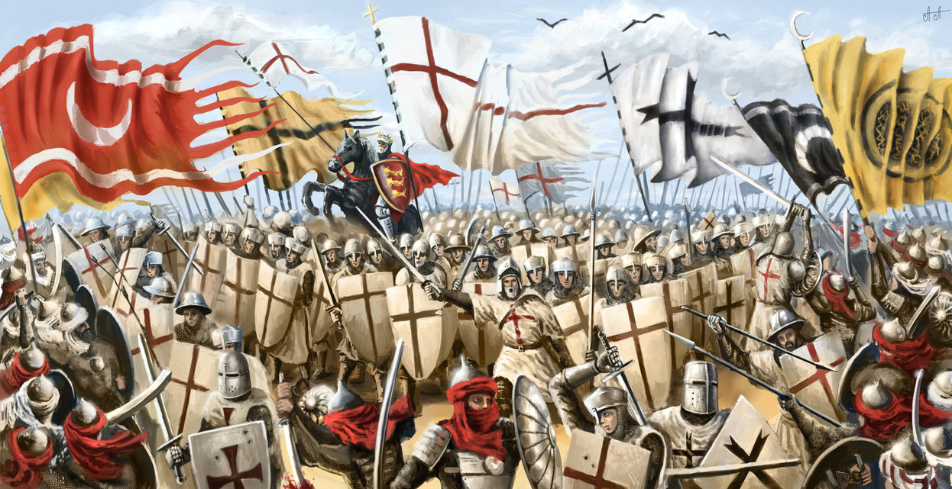
Two Sides in a Crusade – Sources
*Do not Answer Questions on Back

Slide 8
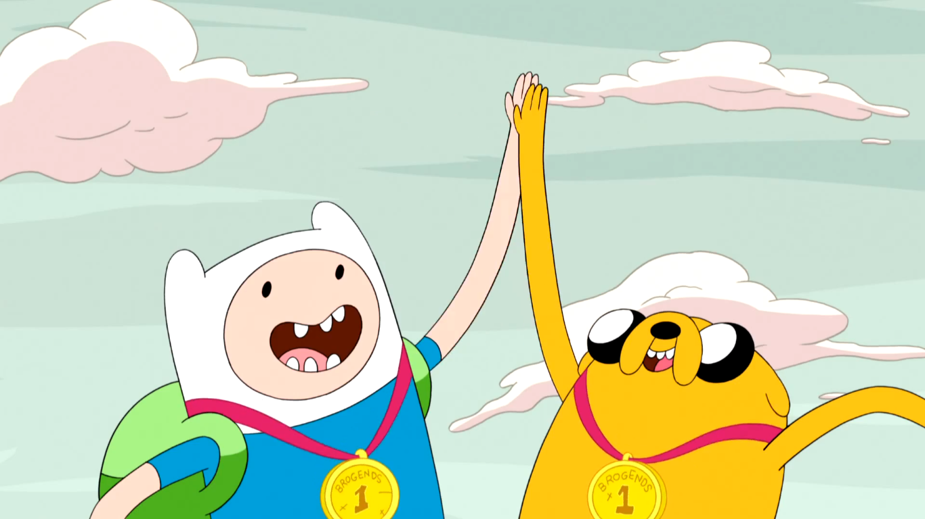
Pair – Share

Slide 9
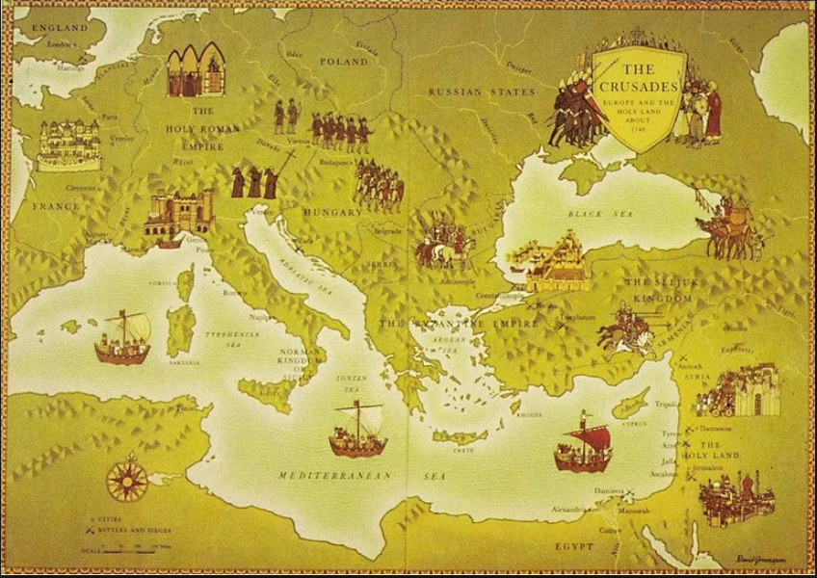

Slide 10
1. From which parts of Europe did most of these Crusaders come from?
2. Which city appears to be the focus of the Crusaders’ efforts? Which Crusade did not make it there?
3. How many years separated the First and the Fourth Crusades?
4. Do the Crusaders ever capture Jerusalem? What is your evidence?
5. ‘The Book of the Lion’ is about the Third Crusade. This one is often called the “Kings’ Crusade” because of the European kings who went. According to the map, who were the three European kings who participated in the Third Crusade?
6. The area around the Jerusalem is often called the Holy Land. Whose “dominion” was the Holy Land at the time of the Third Crusade? Was this dominion Christian or Muslim?
7. How are the routes the different kings took to the Holy Land different from each other? Who do you think took the longest to get there? Why?
8. About how far is the journey from England to Acre by way of Italy? How far by the way that King Richard traveled?

Slide 11
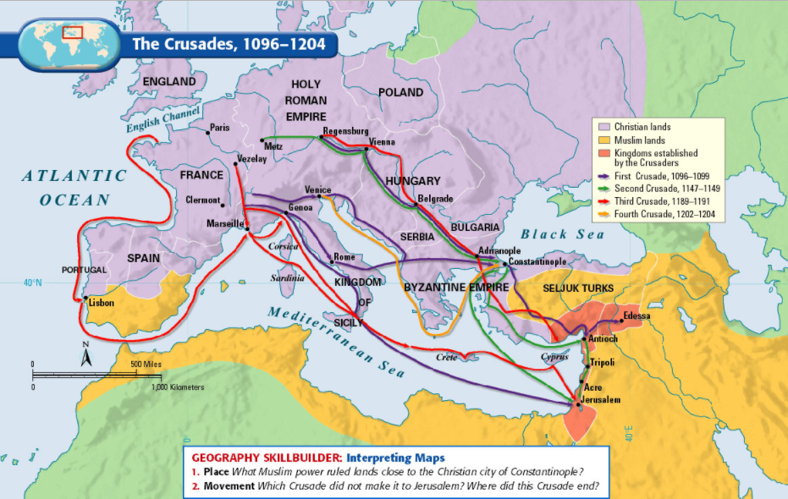

Slide 12
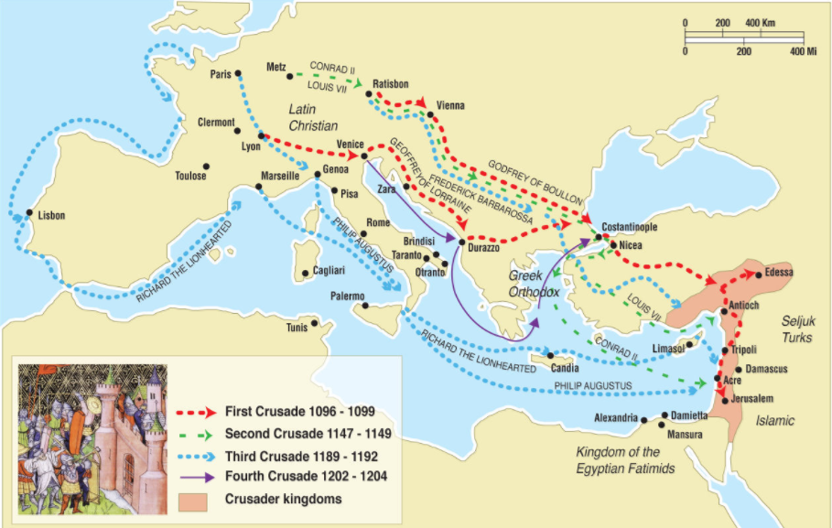

Slide 13
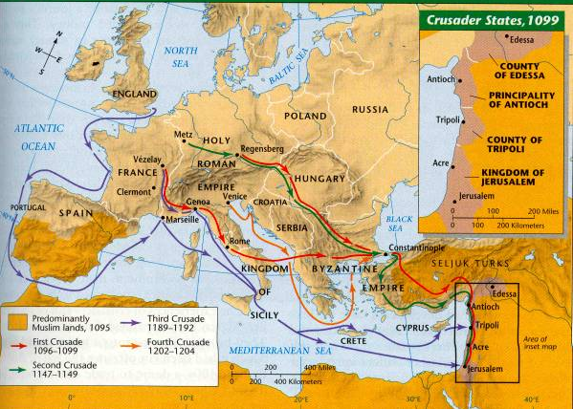

Slide 14
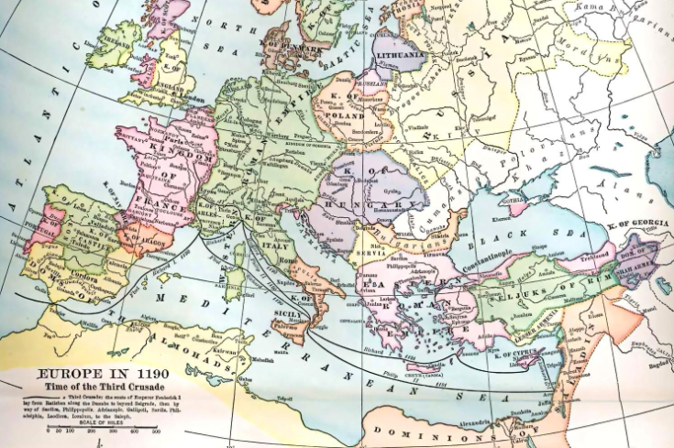

Slide 15
Put a dot at and label in black the cities of Lyon, London, Rome, Venice, Constantinople, and Acre.
Put a dark colored star at and label the city of Jerusalem.
In a dark color, label England, France, Holy Roman Empire, and Byzantine Empire.
In a different dark color, label the Muslim dominions of the Seljuk Turks and Saladin.
Draw and label the paths taken by King Richard the Lionhearted and Geoffrey of Lorraine to Jerusalem.
Lightly shade all Christian lands.
Lightly shade all Muslim lands.
Make a color key that explains #7 & 8
On the reverse of this page complete the 5 questions

Slide 17
Pope Urban II - Called on Christians from all over Europe to retake the Holy Land from the Muslim Turks.
Byzantine Empire - The old “eastern half of the Roman Empire” Seljuk Turks - Muslim Turkish tribe
Review:
What city does the Pope live in?
Where is the Byzantine Empire compared to Rome?
What religion is the Byzantine Empire?
What religion is the Holy Land in the Middle Ages?
Where are the Seljuk Turks located?

Slide 18
Using the TCI pages 118 -121, organize the Crusade events in the correct chronological order (Take notes of these)
General Example of chronological organization
Dinosaurs go extinct
Some wars and stuff
Democracy, unprecedented human achievement and technological advancements
Cat videos

Slide 19
Seljuk Turks take control of Palestine (the Holy Land)
Christian pilgrims to the Holy Land are attacked
The Turks also advance to within 100 miles of the Byzantine Empire’s capitol
The Byzantine emperor asks Pope Urban for help
Pope Urban calls on lords and knights to go on the 1st Crusade
30,000 Crusaders arrive in Jerusalem in 1099 C.E.
The Crusaders massacre Muslims and Jews in Jerusalem

Slide 20
They establish four Crusader kingdoms in the Holy Land
The Seljuk Turks recapture part of the Holy Land, which results in the 2nd Crusade, which fails
In 1187, Saladin, a great Seljuk Turk leader recaptures Jerusalem and most of the Holy Land
Richard the Lionhearted leads the Crusaders to recapture Jerusalem in the 3rd Crusade
The Crusaders fail on this and future Crusades for the next 100 years!

Slide 21
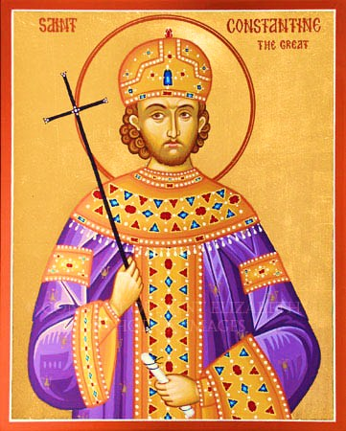
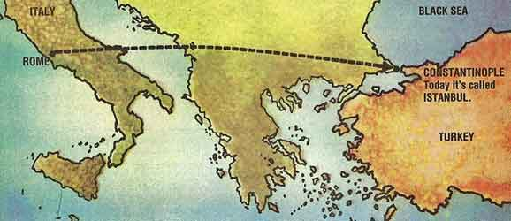
Review
Two decisions Constantine made that would change European and Middle Eastern history:
He gave Christianity legal standing within the empire.
In 330 CE, he moved the capital from Rome to Constantinople, a small seaside trade town in modern-day Turkey.

Slide 22
Religion and government in the Byzantine Empire:
The emperor was both the head of the government and the living representative of Jesus Christ.
Emperor had supreme authority in the church.
One of the main reasons for the split from the Roman Catholic Church was because Constantine refused to accept the power of the Pope
The Church was an essential part of everyday life

Slide 23
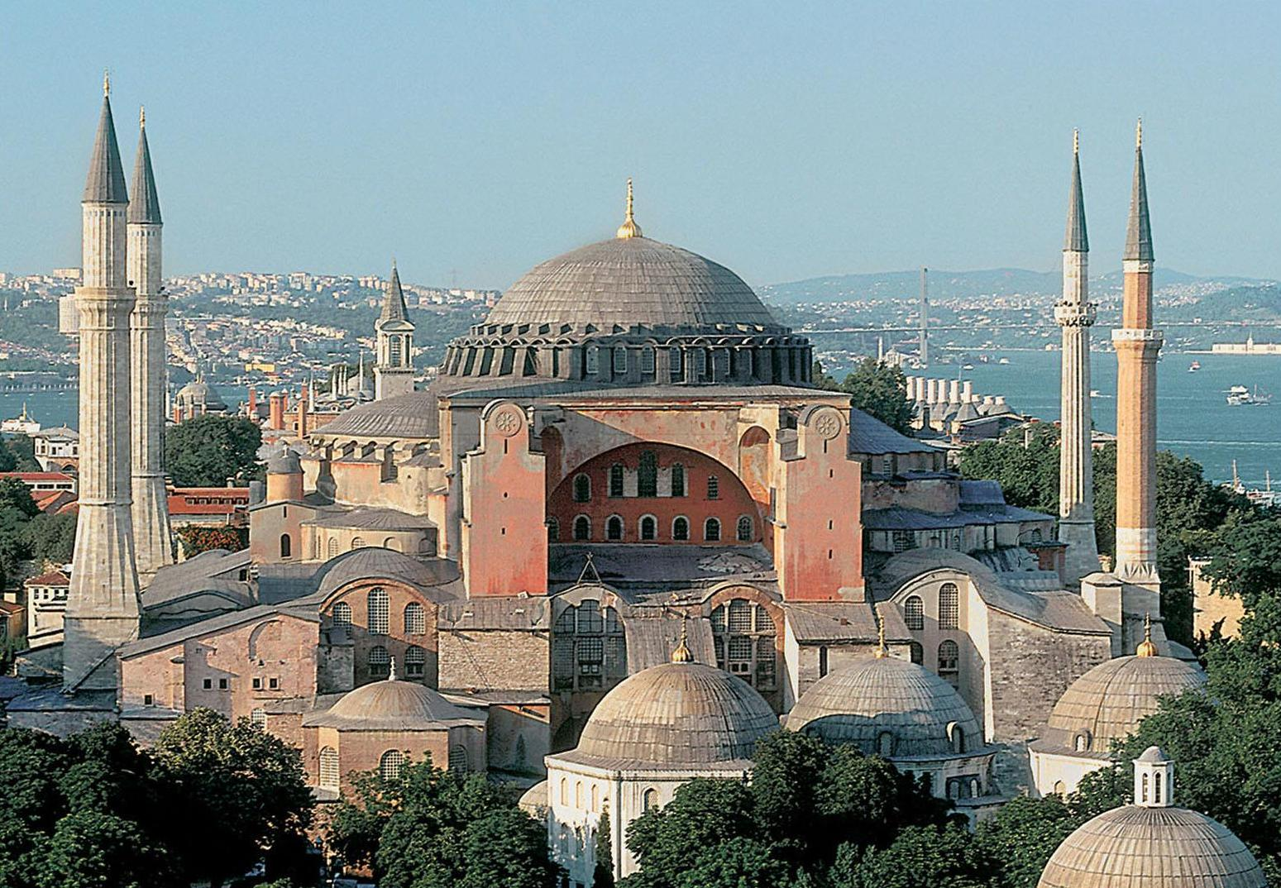
Hagia Sophia

Slide 24
Built in 537 as Orthodox Christian Cathedral and Seat of the Patriarch or Constantinople except between 1204 and 1261 when converted to a Roman Catholic Cathedral by the Fourth Crusaders
Converted into an Ottoman Mosque between 1453 and 1931
A secular museum since 1935
Inspired Theed palace on Padme’s home planet of Naboo in Star Wars

Slide 25
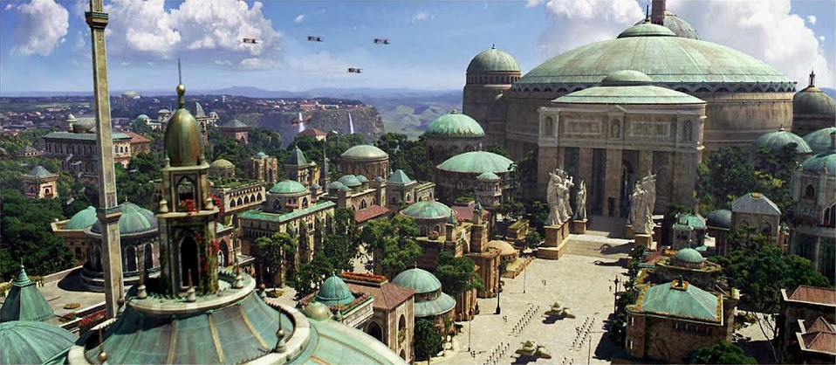
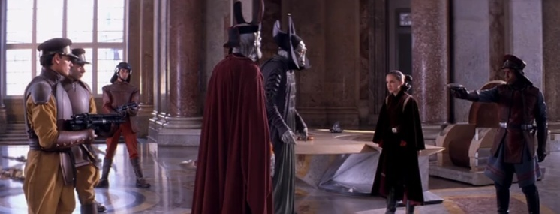

Slide 26
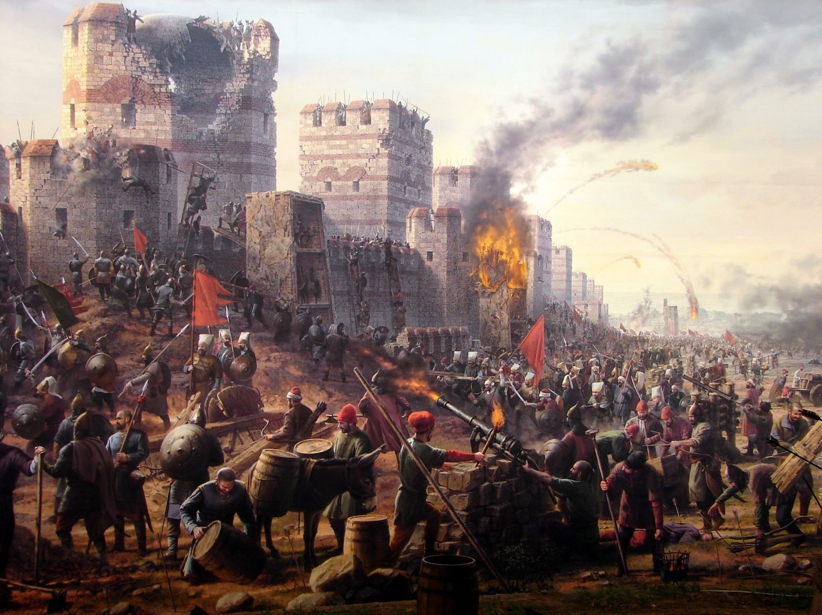
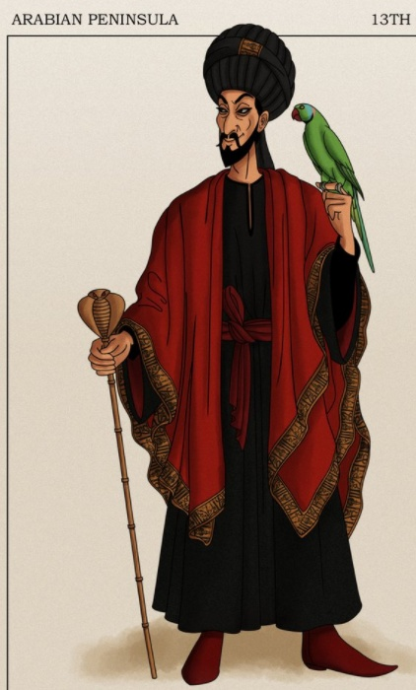
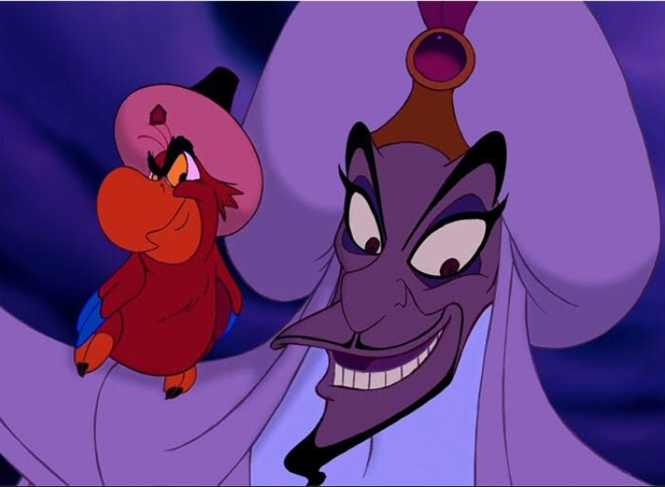
Ottoman Turks take over the Byzantine Empire. Constantinople falls in 1453, it becomes Istanbul. The Turks were Muslim. The and the Orthodox Religion is forever changed.

Slide 27
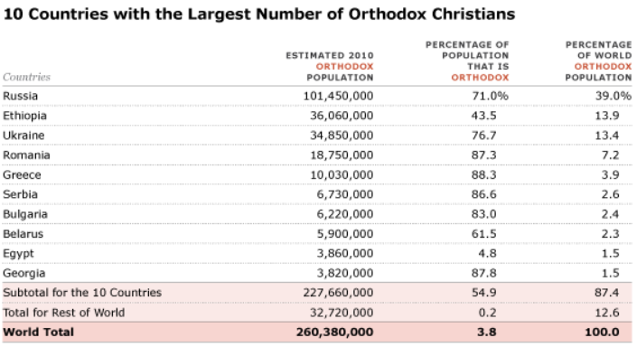
Do you notice anything strange based on what we have been talking about?
FYI: American Orthodox Christians Number around 700,000 = 0.25% of U.S. Population, 0.3% of Orthodox Population

Slide 28
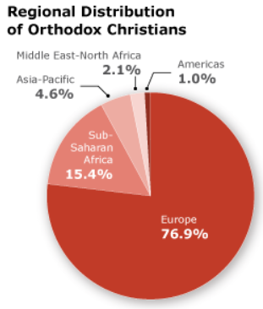
Would it be accurate to say the Patriarch of Constantinople (who used to be the Patriarch of the entire Byzantine Empire) has great power over Russia, Ethiopia and Ukraine today?

Slide 29
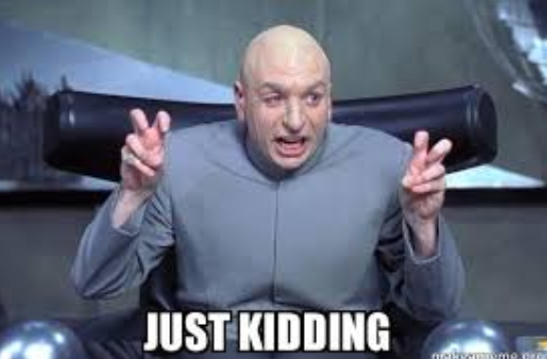
Crusaders Test
On Monday
35 Multiple Choice
5 Short Answer – 2 to 3 sentences each
2 Essay Responses – 5 to 6 sentences each (based on primary sources)

Slide 30
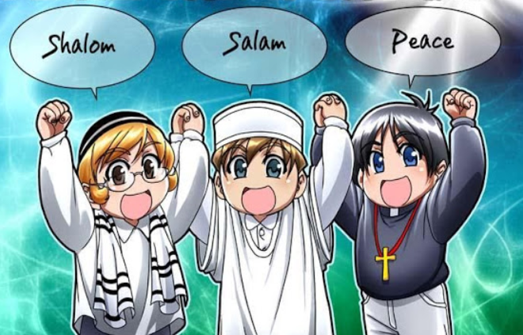
How did the Crusades affect the lives of Christians, Jews, and Muslims…

Slide 31
Read the questions to research.
Silent read your information.
Discuss answers to the four questions with your partner.
Write your three-sentence answer.
Practice interviewing each other (hold out pencil upside down and switch) on the questions.

Slide 32
CRUSADER NEWS DAILY

Slide 33
REMEMBER: This is your assessment, it is going in as a test grade – You need to take it very seriously, I will be coming around and asking questions as well as sitting with you and your partner. It is also essential that you do not just use your knowledge from the document you read immediately prior to this interview but also use the information we have learned throughout this (mini) unit on the Crusades. If your partner is struggling make sure at least you are doing your part!

Slide 34
Crusader News Interview Questions
Who are you?
How were you involved in the Crusades?
What is most significant or memorable about your figure’s participation in the Crusades?
What would you say was the “high point” of the Crusades for you?
What would you say was the “low point” of the Crusades for you?

Slide 35
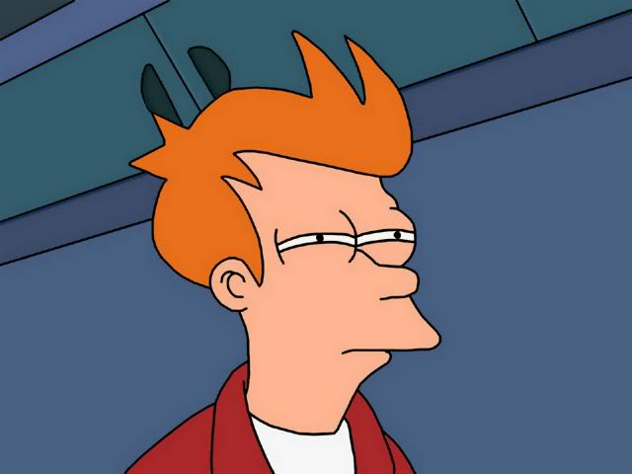
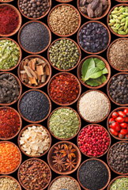
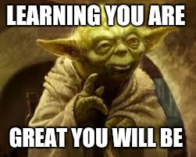
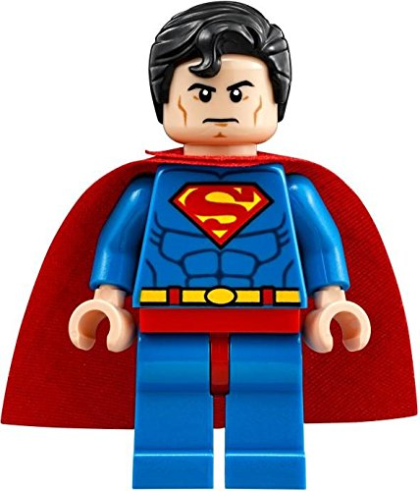
What were long-term effects of the Crusades?
Montage Playlist: “Effects of the Crusades”

Slide 36
